Slide 1
Applied Vehicle Dynamics Control SD2231 Lab 3
Alireza Qazizadeh
April 28, 2020

Slide 2
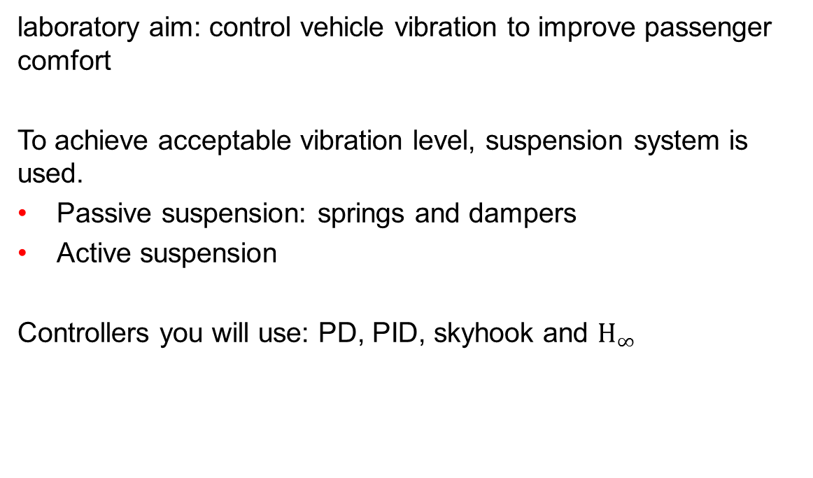
Introduction
laboratory aim: control vehicle vibration to improve passenger comfort
To achieve acceptable vibration level, suspension system is used.
Passive suspension: springs and dampers
Active suspension
Controllers you will use: PD, PID, skyhook and $H_{∞}$

Slide 3
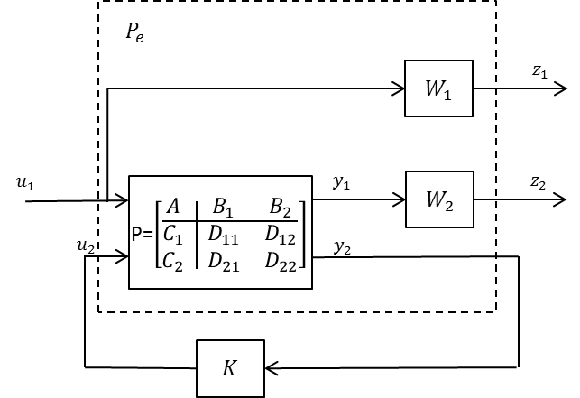


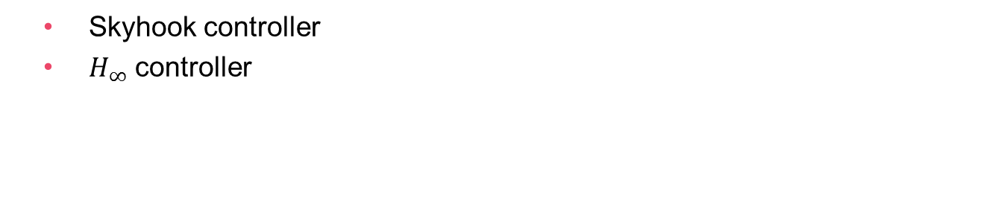



Theory:
Skyhook controller
$H_{∞}$ controller
$$c_{p}$$
$$z_{p}$$
$$m_{p}$$
$$k_{p}$$
$$z_{w}$$
Track Irregularities

Slide 4




















Skyhook
Damper Skyhook
$F_{c_{p}}={−c}_{p}.({\dot{z}}_{p}−{\dot{z}}_{w})$ $F=−c_{p}.{\dot{z}}_{p}$
Implementation:
$$z_{p}$$
$$m_{p}$$
$$c_{p}$$
$$z_{p}$$
$$m_{p}$$
$$k_{p}$$
$$c_{p}$$
$$k_{p}$$
$$z_{w}$$
Track Irregularities
$$z_{w}$$
Track Irregularities
Accelerometer
$${\ddot{z}}_{p}$$
integrator
$${\dot{z}}_{p}$$
$$1/s$$
$$−c_{p}$$
Vibration isolation by decoupling the body from track or road irregularities.
$$z_{p}$$
$$m_{p}$$
$$k_{p}$$
$$F$$
$$z_{w}$$
Actuator
controller
Track Irregularities
4

Slide 5
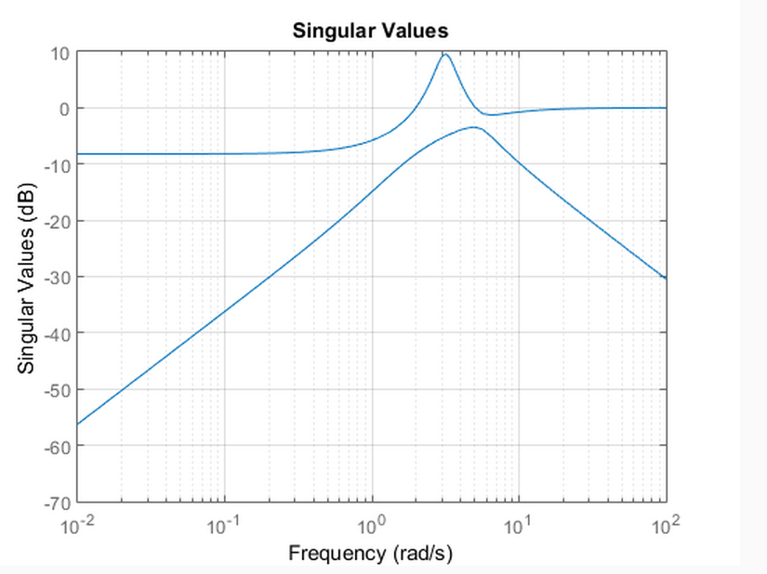


$H_{∞}$norm:
Infinity norm of a SISO system with transfer function $P(s)$ is:
$${\left\|P(s)\right\|}_{∞}=\sup_{w}{ \left|P(iw)\right|}$$
For a MIMO system:
$${\left\|P(s)\right\|}_{∞}=\sup_{w}{ \left|\overline{σ}(P\left(iw\right))\right|}$$

Slide 6
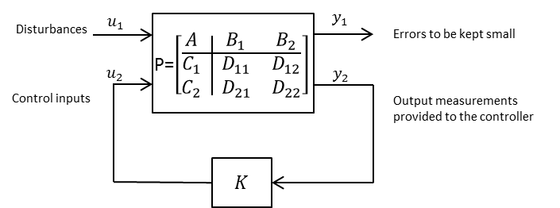

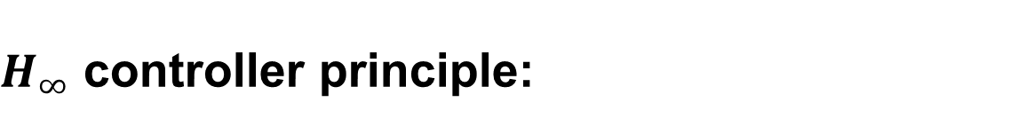
$H_{∞}$ controller principle:
Consider plant $P$
The aim is to design a controller so that the closed-loop system ($CL$) infinity norm is minimum.
$γ={\left\|CL\right\|}_{∞}$

Slide 7


Extending the model $P$ with weighting functions
One can extend the model $P$ with weighting functions.
Design controller $K$ for $P_{e}$
Why? to penalize the desired signals at the desired frequencies.

Slide 8
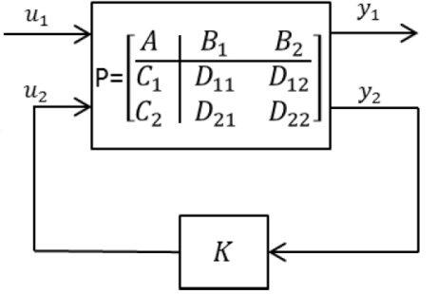


Contd.
Having the weighting functions, controller $K$ can be designed by Matlab.
Unsatisfactory response: Change the weighing functions and look for a new controller.
Test: to check the performance of the derived controller $K$, it should be implemented in the control loop of the main model.

Slide 9
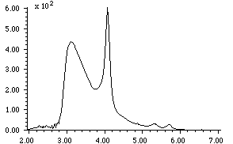




$H_{∞}$ concept
$H_{∞}$ norm:
of a transfer function is its maximum magnitude over the whole frequency range.
${\left\|T(iw)\right\|}_{∞}=\sup_{w}{ \left|T(iw)\right|}$
T(s)
r
$$P(s)$$
y
$H_{∞}$ control tries to design the controller $K$ such that the infinity norm of the closed loop transfer function $T(s)$ is minimized.
We can focus this minimization process on specific frequency ranges by proper weighting functions $W(s)$ (penalizing)
+
-
$$K(s)$$
$$W(S)$$
frequency

Slide 10
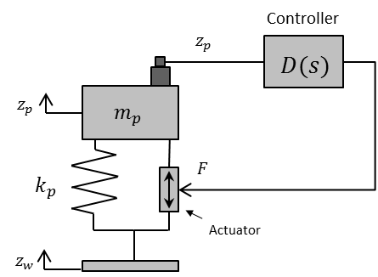
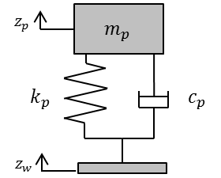
Control of a single degree of freedom (SDOF) system
Passive
Damped
Undamped
Active
PD
PID
Skyhook
Excitation:
Sinusoidal excitation (compare with frequency response function)
Impulse response
Response to track excitation (PSD)

Slide 11
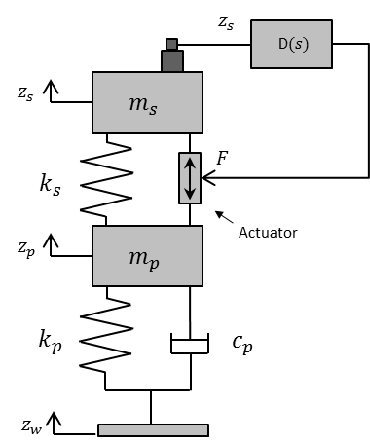
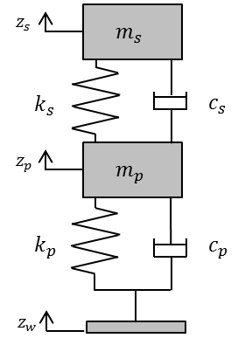
Control of a 2 degrees of freedom system
Passive
Damped
Active
Skyhook

Slide 12
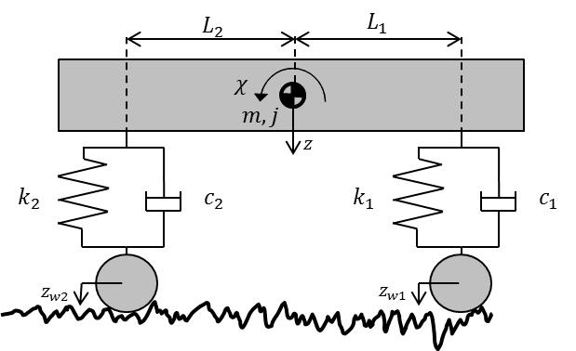
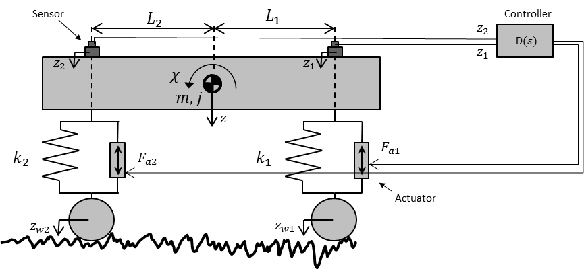

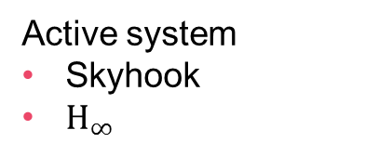
Control of bounce and pitch using Skyhook and $H_{∞}$
Passive system
Active system
Skyhook
$H_{∞}$

Slide 13
Report writing
Good report: information needed for the reader to understand the results and nothing more.
Start working with the report from the start by writing down each of the steps you have done.
Including the approach, gathered information and the rationale of each of the steps.
-Do not forget to answer the questions in the handout!
-You should use the template on Canvas for your final report.

Slide 14
Notes
Teachers supporting this Lab:
Rocco Giossi, roccolg@kth.se
Alireza Qazizadeh, alirezaq@kth.se
Supplementary material:
If you have problem with deriving Equations of motion and transfer functions, read chapter 5 of the ‘Rail Vehicle Dynamics book’. The file is named ‘Rail vehicle dynamics-chap5’ and you can find it on Canvas. Sections 5.1 and 5.3 can be very helpful.

